Slide 1

WANDERHUB: A SMART TOURISM PLATFORM
TEAM NO. : 664
COURSE TITLE: PROJECT-I
COURSE CODE: BCSE497J
FACULTY GUIDE: DR. RADHIKA SELVAMANI
TEAM MEMBERS:
Krish goel (21bce6097)
MEGHNA DAS (21BCE1422)
GODAVARI TANMAYI (21BCE5976)

Slide 2
INTRODUCTION
WanderHub is an intelligent tourism platform developed to revolutionize how travelers plan and experience their journeys.
By utilizing data-driven insights and cutting-edge optimization algorithms, WanderHub personalizes hotel recommendations and travel itineraries based on each user’s unique preferences, such as budget, activities, and health considerations.
Recognizing the limitations of traditional platforms, which often fail to address individual needs effectively, WanderHub employs Genetic Algorithms and Simulated Annealing to create customized travel plans, reducing the time and effort needed for manual planning.
This approach enhances traveler satisfaction and makes the planning process both seamless and enjoyable.
An essential feature of WanderHub is its use of Counterfactual Analysis, allowing users to explore alternative scenarios by modifying specific travel parameters, such as budget or hotel ratings.
This “what-if” functionality offers flexibility and adaptability, empowering users to make well-informed choices suited to changing travel conditions.
By integrating these smart capabilities, WanderHub addresses key pain points in the tourism industry, such as decisional fatigue and information overload, offering a comprehensive solution that benefits both travelers and tourism providers.

Slide 3

PROBLEM STATEMENT
A huge challenge in the tourism industry lies in being able to offer customized, efficient travel planning solutions. Much time is lost in manual planning and subsequently leads to suboptimal choices because of information overload and the complexity of balancing numerous preferences, including budget, activities, accommodations, and health considerations. The current systems do not involve itinerary planning, make generic recommendations with no regard for the interests of each traveler, nor allow for the analysis of specific alternative scenarios involving specific constraint. This is associated with traveler dissatisfaction, decisional fatigue affecting 65 percent of travelers, inefficient utilization of resources, and potential business lost in the tourism industries. The Intelligent Tourism Recommendation System would address such major challenges by creating a joined-up platform that not only includes AI-driven optimization capabilities for the itinerary but personalizes hotel recommendations as well as enables counterfactual analysis. The solution will actually help these travelers make the right decision, and tourism businesses better understand their clients' needs.

Slide 4
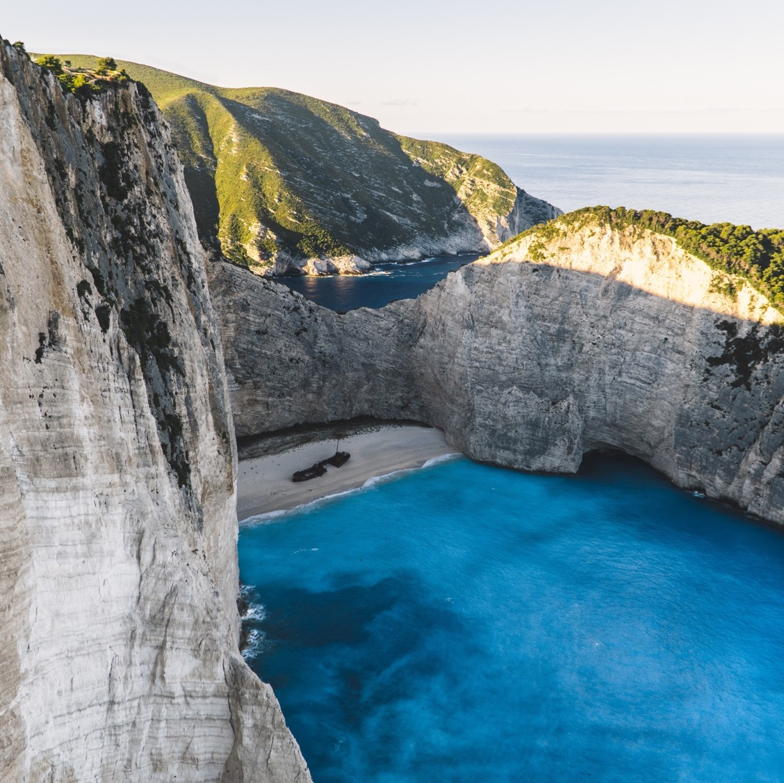
RESEARCH OBJECTIVES
To develop a recommendation system that suggests hotel details based on user preferences.
To develop a counterfactual-based recommendation system providing alternative options if any “What-if” scenario arises.
To design and implement a genetic algorithm and simulated annealing approach to optimize travel itineraries based on user preferences.

Slide 5
PROPOSED SYSTEM

Slide 6
PROPOSED SYSTEM – INTRODUCTION
The system is a comprehensive tourism recommendation service that features intelligent itinerary optimization as well as hotel recommendations and support for counterfactual analysis.
Main Functionalities
Hotel Recommendation Service
Functions
Gives personalized hotel recommendations based on user profiles and preferences.
Offers counterfactual analysis for alternative scenarios.
Smart Itinerary Optimizer
Functions
Provides optimized travel itineraries to the user based on preferences utilizing the Genetic Algorithm and Simulated Annealing.
Optimizes based on several conflicting variables, such as sun exposure, fitness, sightseeing, nightlife, and health risks.

Slide 7
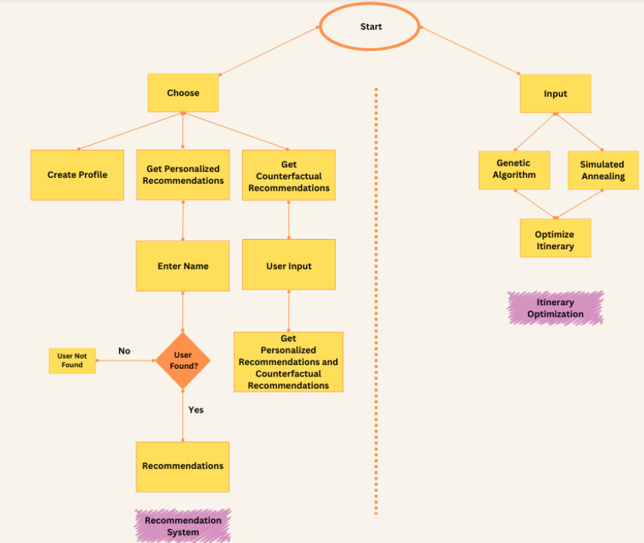
PROPOSED SYSTEM – DIAGRAM
This project begins with users choosing between profile creation, personalized recommendations, or counterfactual recommendations. Based on input, it checks if the user exists in the system, providing customized suggestions if found. Simultaneously, itinerary optimization uses the Genetic Algorithm or Simulated Annealing for efficient planning. This combined approach personalizes travel recommendations while optimizing user itineraries.

Slide 8
PROPOSED SYSTEM – LIST OF MODULES
HOTEL RECOMMENDATION
ITINERARY OPTIMIZATION
User Profile Manager – Manages creation and storage of user profiles.
Components : Profile Creator, Profile Storage, and Profile Retriever
Recommendation Engine – Generates hotel recommendations based on user preferences.
Components : Hotel Filter, Amenity Matcher, and Recommendation Sorter
Counterfactual Analysis – Generates alternate recommendations based on modified parameters.
Components : Budget Range Calculator, and Rating Range Expander
User Preferences – Manages user preferences and calculates utility scores for itineraries.
Components : Constructor, and Utility Calculator
Itinerary – Represents a single travel itinerary with its characteristics.
Components : 5 key metrics (Sun Exposure, Fitness Level, Sight-Seeing Intensity, Nightlife Activity, Health Risks)
Intelligent Tourist Agent – Core optimization engine that generates and improves itineraries.
Components : Random Itinerary Generator, Optimization Controller, Crossover Operation Handler, and Acceptance Probability Calculator

Slide 9
PROPOSED SYSTEM – EXPLANATION OF MODULES (COUNTERFACTUALS)
Counterfactual reasoning is the analysis of hypothetical scenarios or outcomes contrary to real events or facts.
It is a bit like asking "What if?" and then looking at other possibilities.
For instance, in a loan approval system, a counterfactual analysis might explore how the outcome would change if the applicant's income or credit score were different.
Counterfactual Parameters
Budget range: 20% to 100% of the original budget
Rating range: +2 points or -2 points from original rating

Slide 10
PROPOSED SYSTEM – EXPLANATION OF MODULES (GENETIC ALGORITHM)
A Genetic Algorithm is a search heuristic that mimics the process of natural selection and genetics to find the optimal solution among a set of possible solutions.
It starts with a population of potential solutions, evaluates their fitness using a fitness function, and selects the fittest individuals to reproduce and create new offspring.
Through crossover and mutation, new solutions are generated, and the process is repeated until convergence or termination.
Parameters
Population Size
Number of Generations
Operations
Crossover
Mutation
Selection

Slide 11
PROPOSED SYSTEM – EXPLANATION OF MODULES (SIMULATED ANNEALING)
Simulated Annealing is a stochastic optimization technique inspired by the annealing process in metallurgy.
It starts with an initial solution and explores nearby solutions using a neighborhood search.
The acceptance criterion decides whether to accept a new solution based on a temperature schedule, which controls the probability of accepting new solutions.
As the temperature decreases, the algorithm converges to a near-optimal solution.
Parameters
Initial Temperature
Cooling Rate
Operations
Acceptance Probability calculation

Slide 12
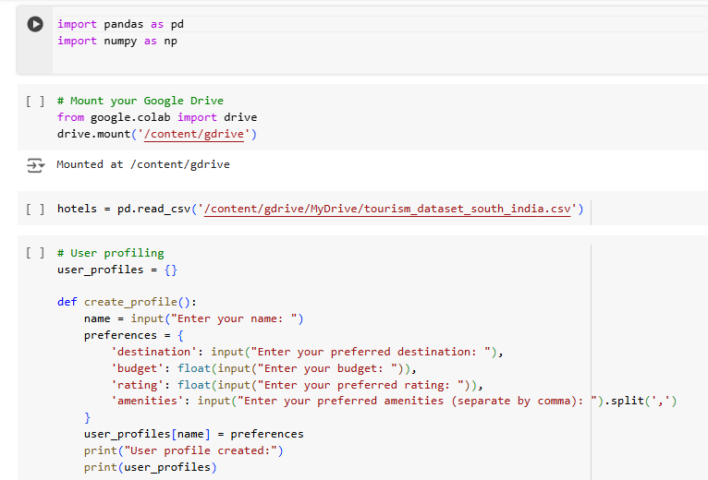
IMPLEMENTATION (HOTEL RECOMMENDATION)

Slide 13
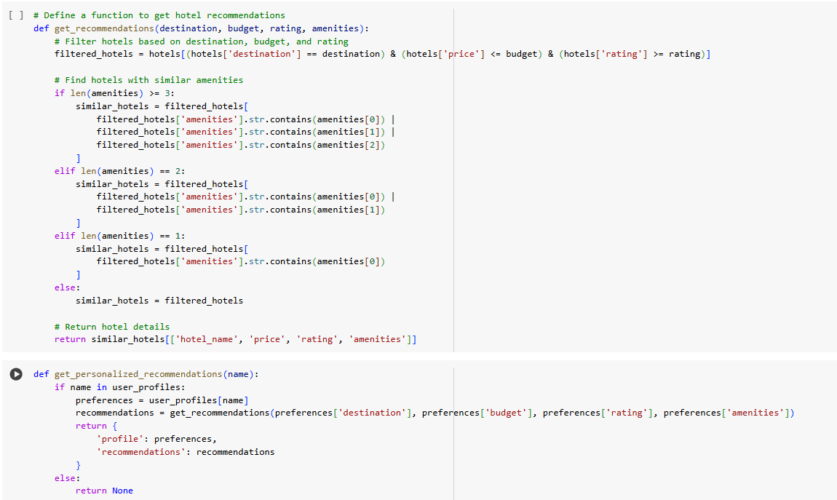
IMPLEMENTATION (HOTEL RECOMMENDATION)

Slide 14
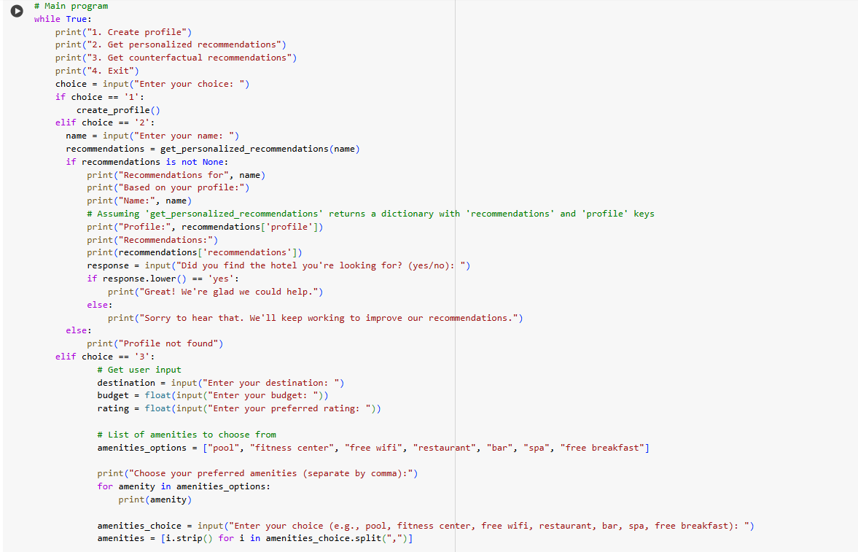
IMPLEMENTATION (HOTEL RECOMMENDATION)

Slide 15
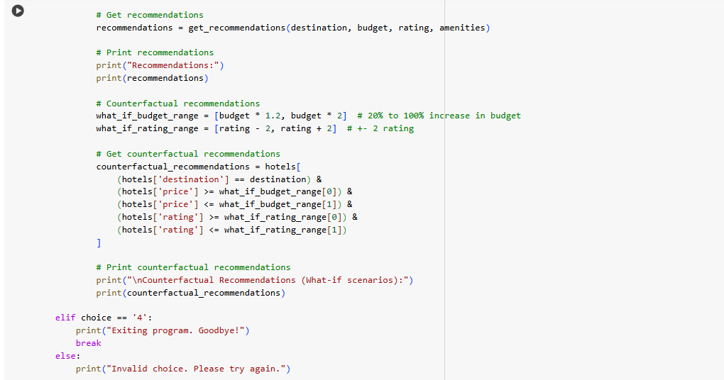
IMPLEMENTATION (HOTEL RECOMMENDATION)

Slide 16
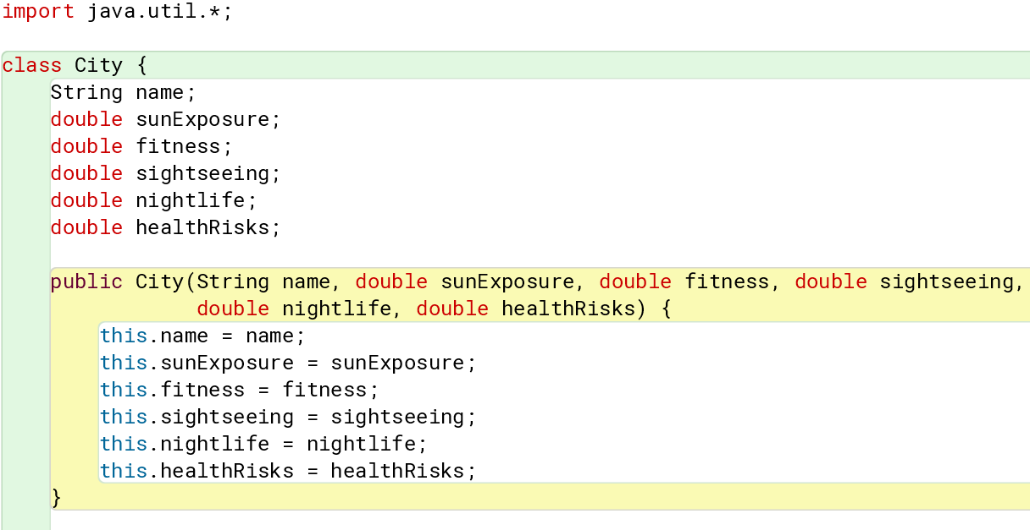
IMPLEMENTATION (ITINERARY OPTIMIZATION)

Slide 17
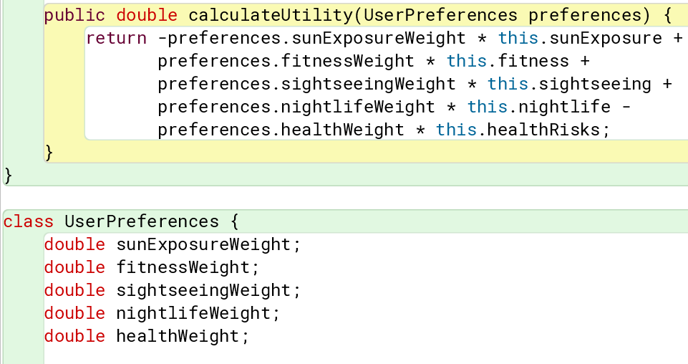
IMPLEMENTATION (ITINERARY OPTIMIZATION)

Slide 18
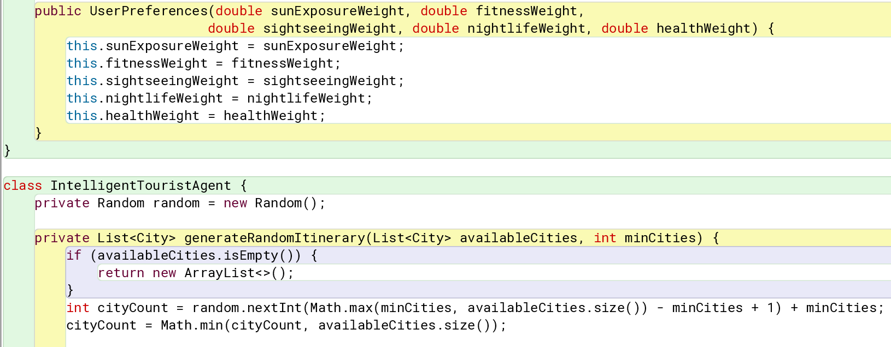
IMPLEMENTATION (ITINERARY OPTIMIZATION)

Slide 19
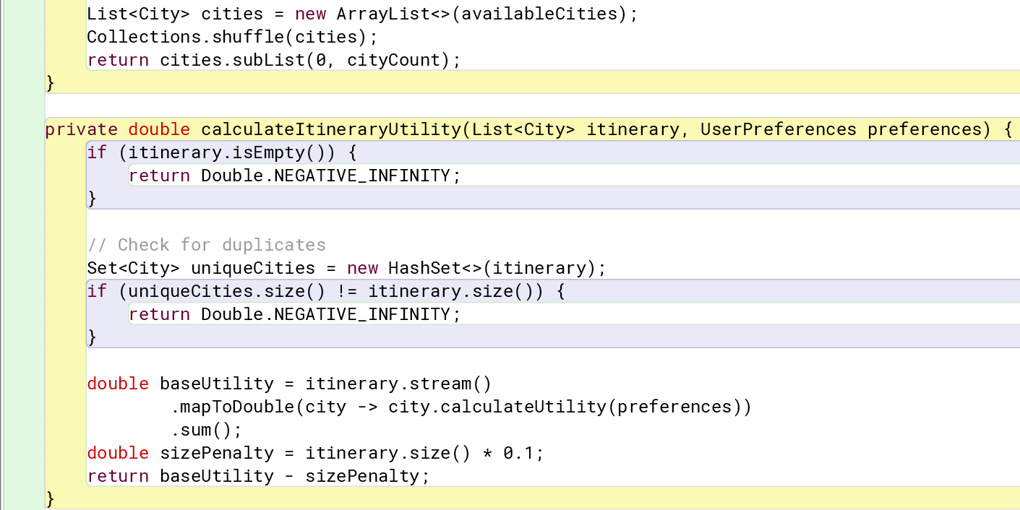
IMPLEMENTATION (ITINERARY OPTIMIZATION)

Slide 20
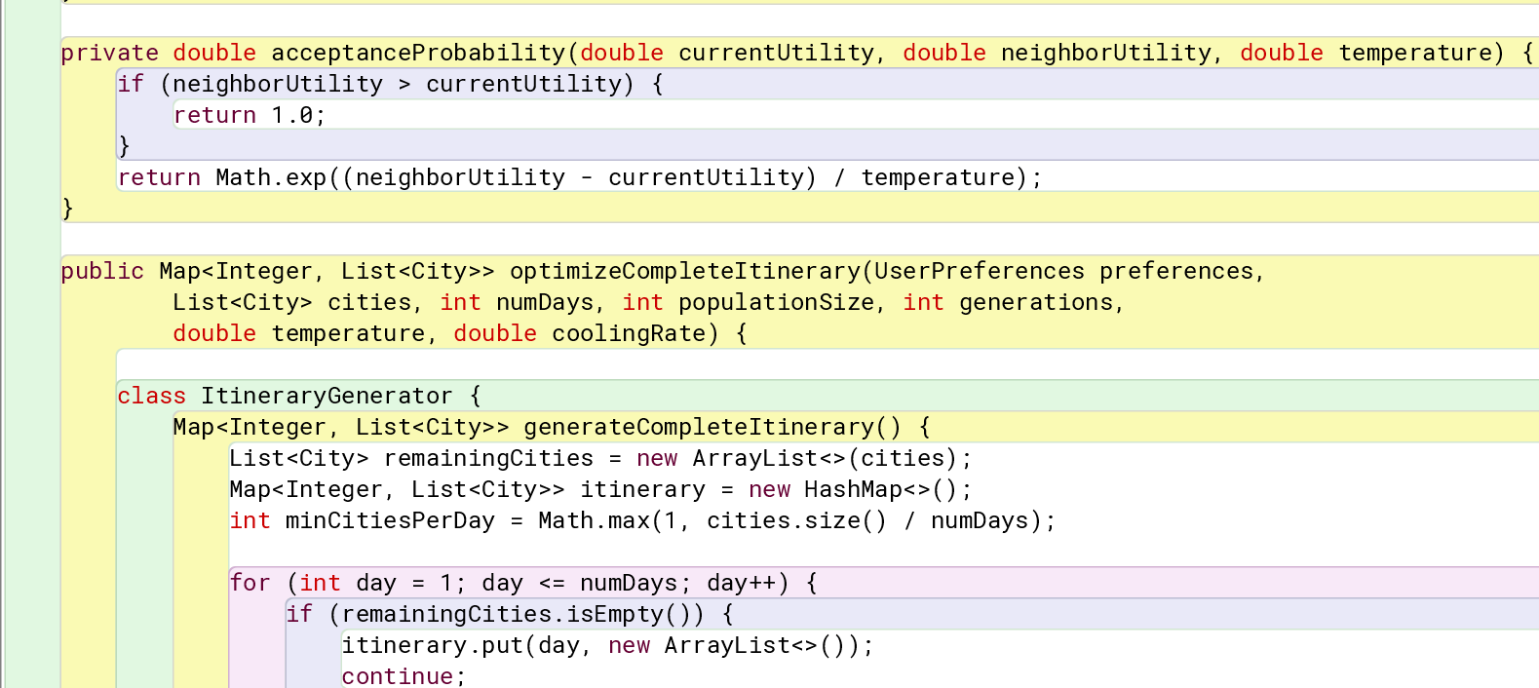
IMPLEMENTATION (ITINERARY OPTIMIZATION)

Slide 21
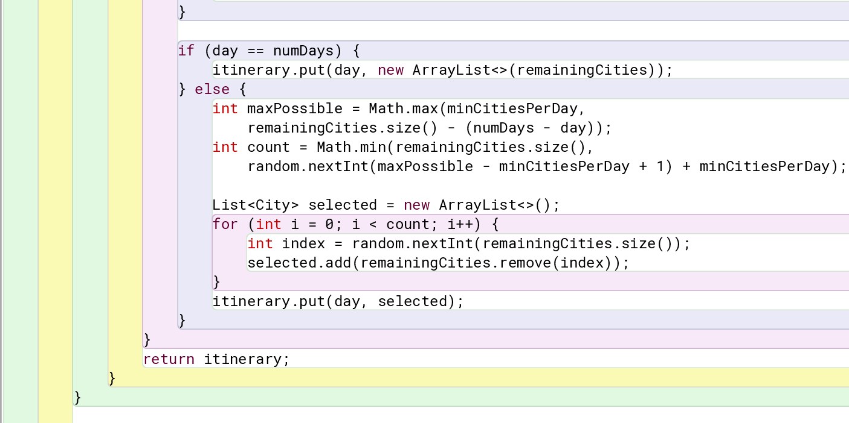
IMPLEMENTATION (ITINERARY OPTIMIZATION)

Slide 22
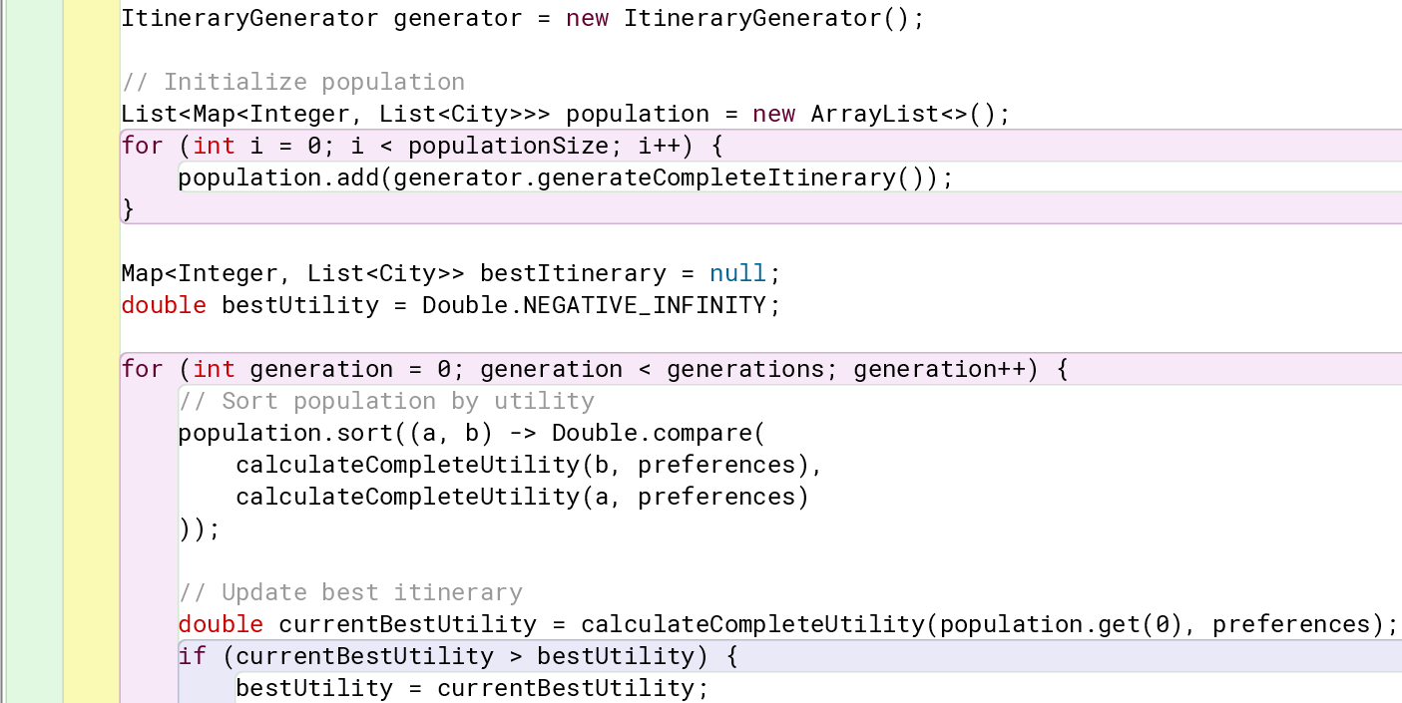
IMPLEMENTATION (ITINERARY OPTIMIZATION)

Slide 23
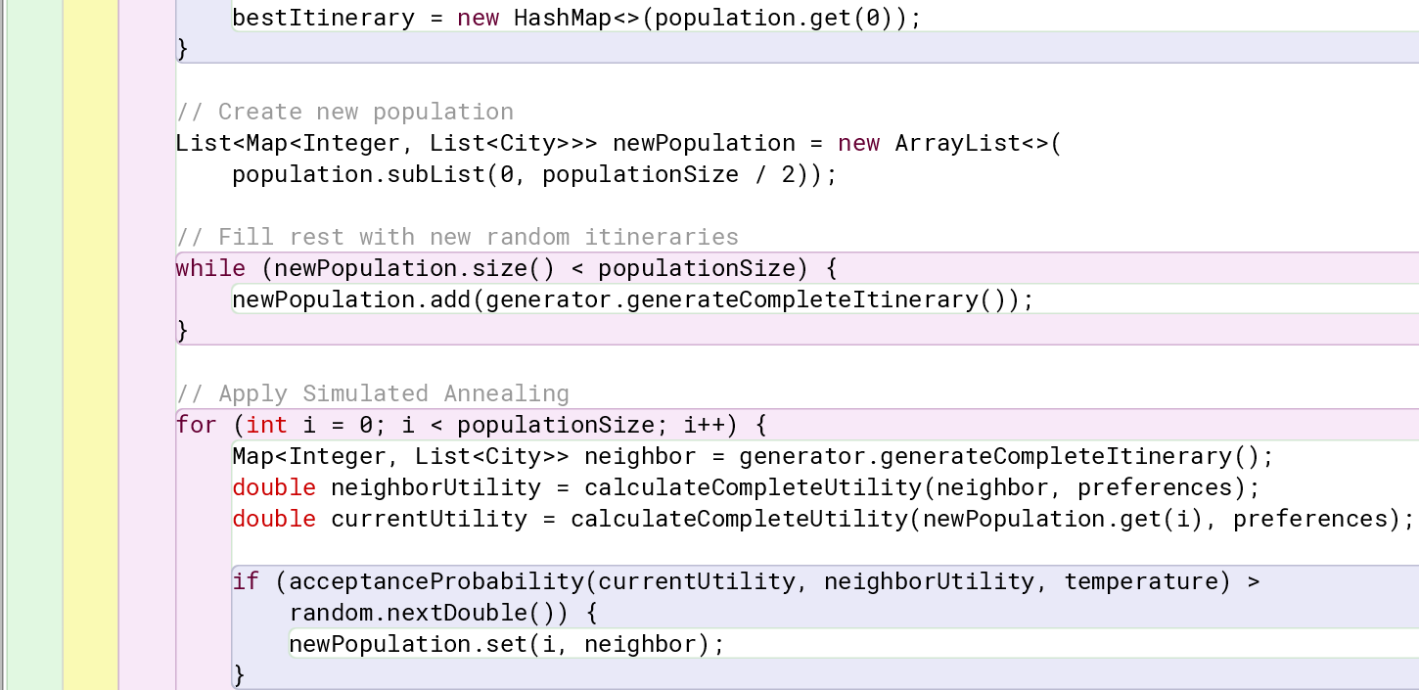
IMPLEMENTATION (ITINERARY OPTIMIZATION)

Slide 24
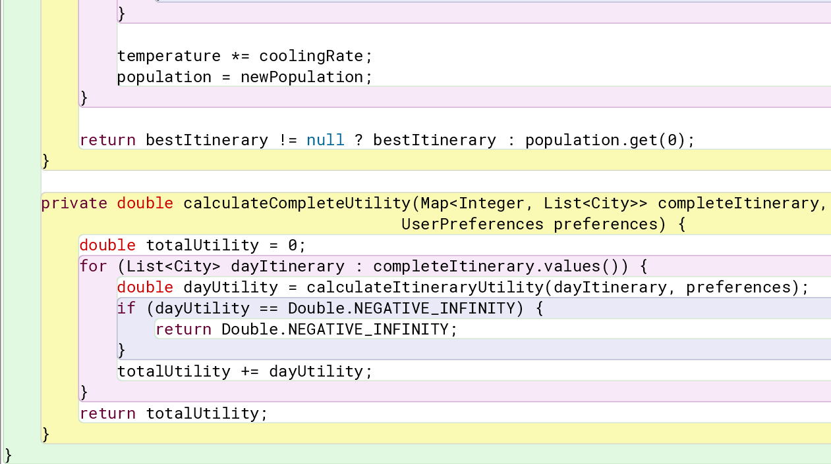
IMPLEMENTATION (ITINERARY OPTIMIZATION)

Slide 25
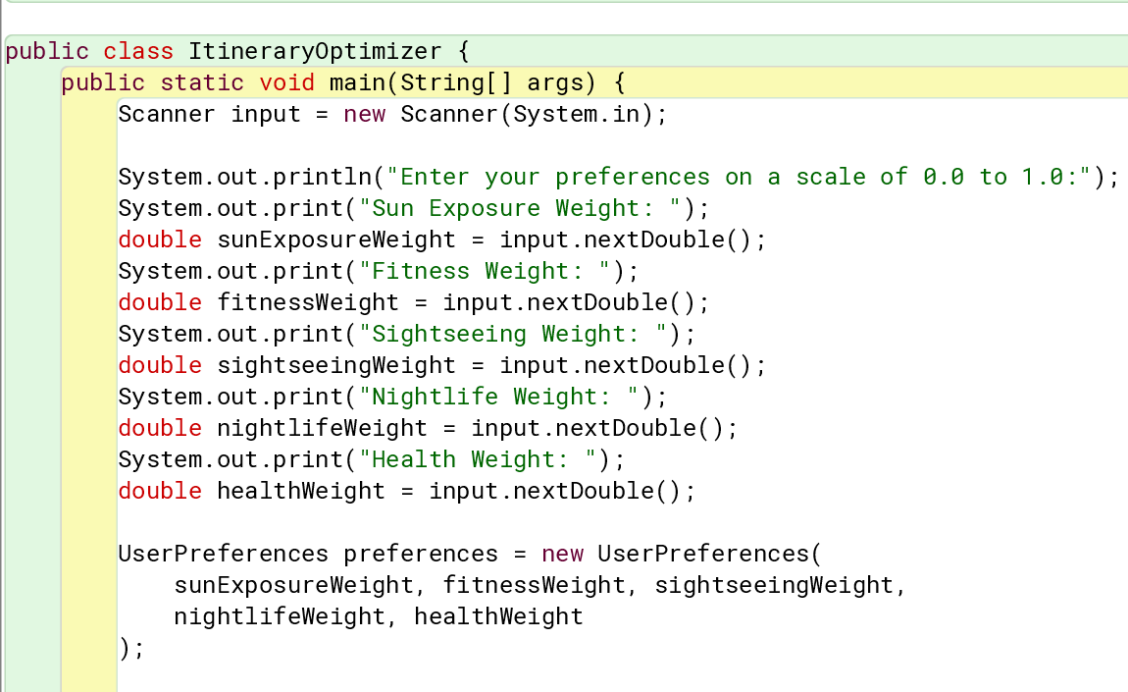
IMPLEMENTATION (ITINERARY OPTIMIZATION)

Slide 26
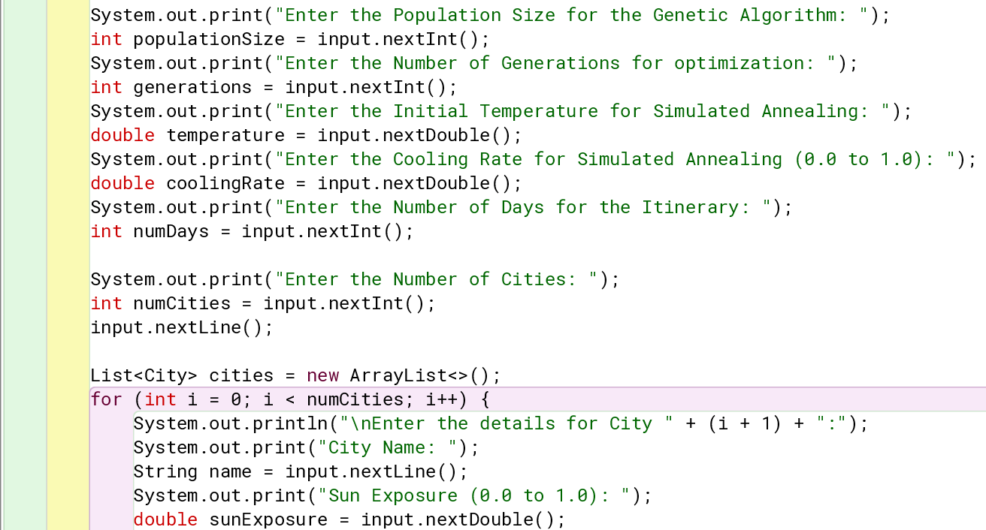
IMPLEMENTATION (ITINERARY OPTIMIZATION)

Slide 27
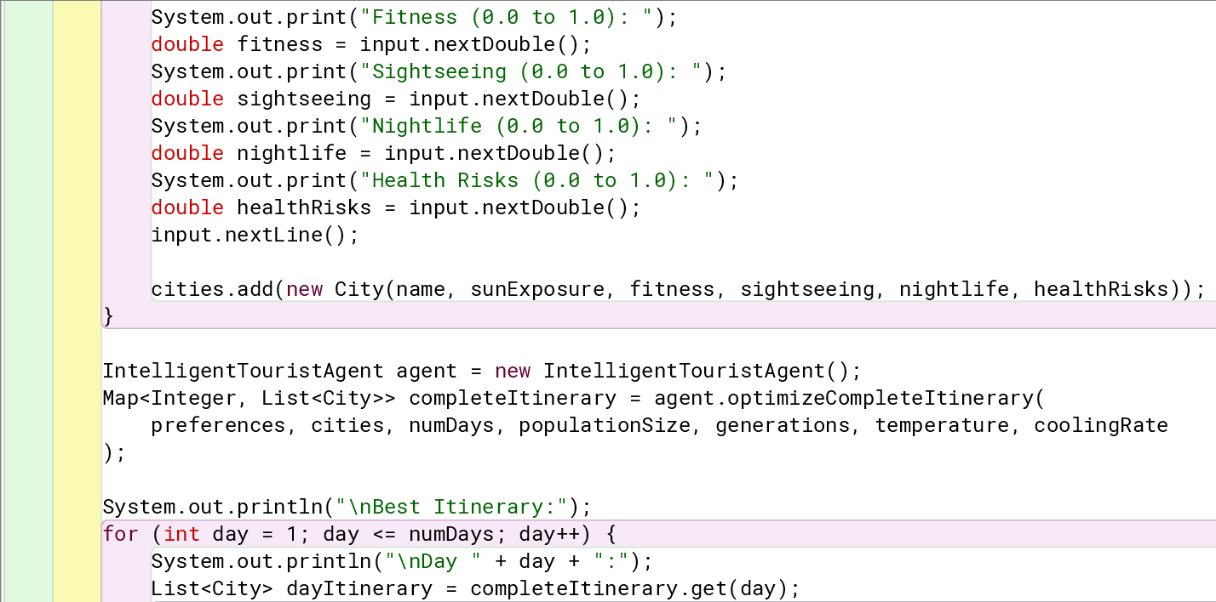
IMPLEMENTATION (ITINERARY OPTIMIZATION)

Slide 28
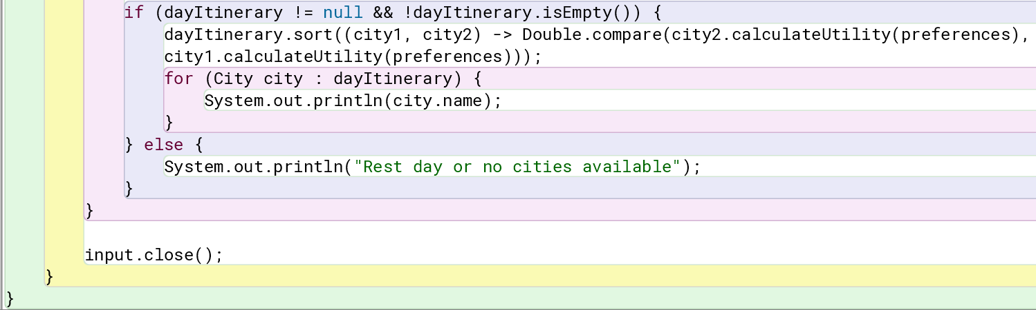
IMPLEMENTATION (ITINERARY OPTIMIZATION)

Slide 29
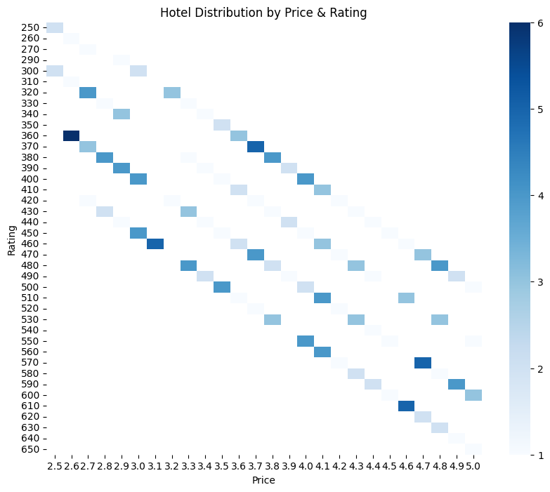
RESULTS (HOTEL RECOMMENDATION)

Slide 30
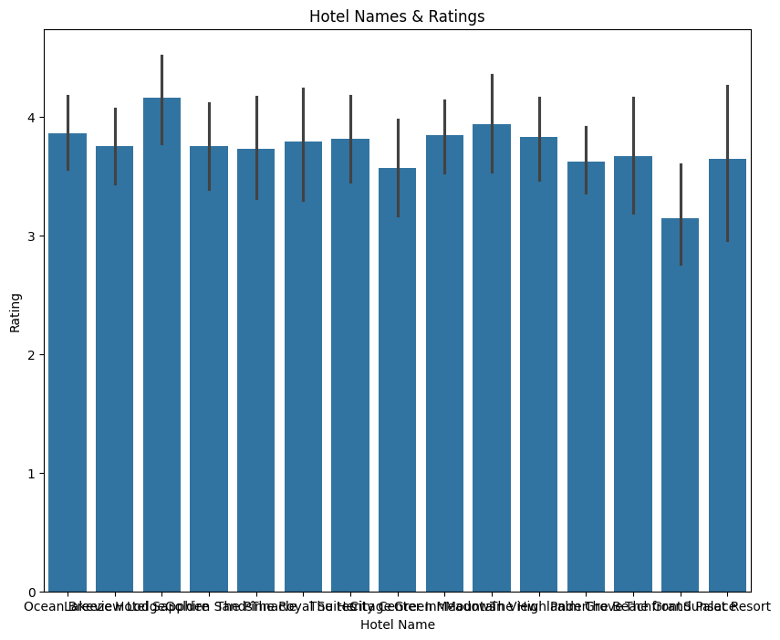
RESULTS (HOTEL RECOMMENDATION)

Slide 31
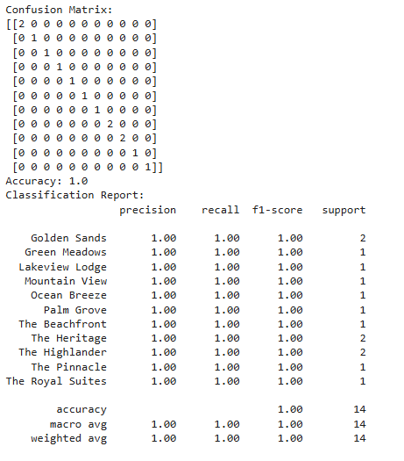
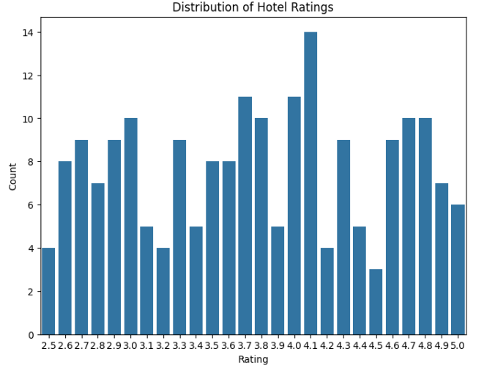
RESULTS (HOTEL RECOMMENDATION)

Slide 32
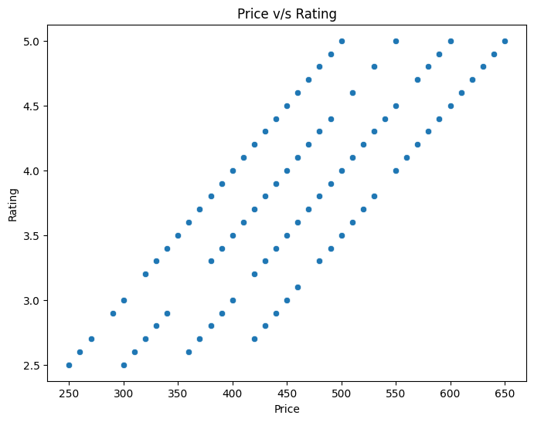
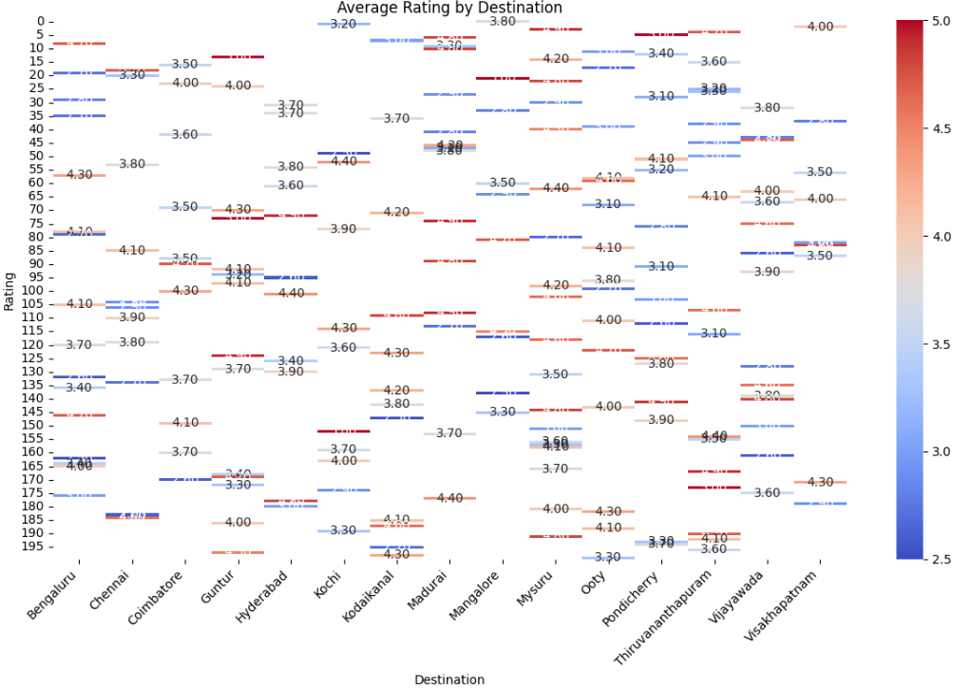
RESULTS (HOTEL RECOMMENDATION)

Slide 33
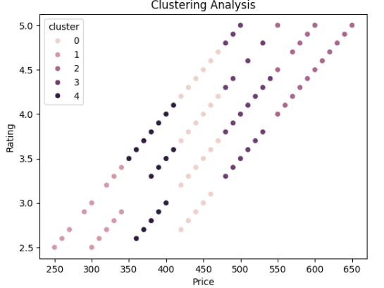
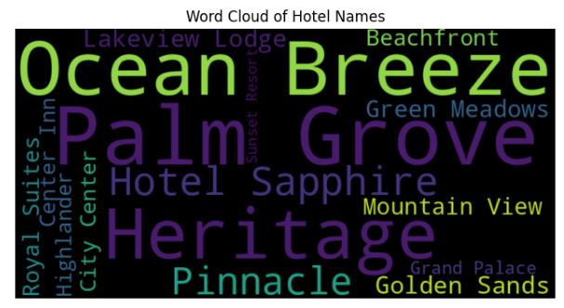
RESULTS (HOTEL RECOMMENDATION)

Slide 34
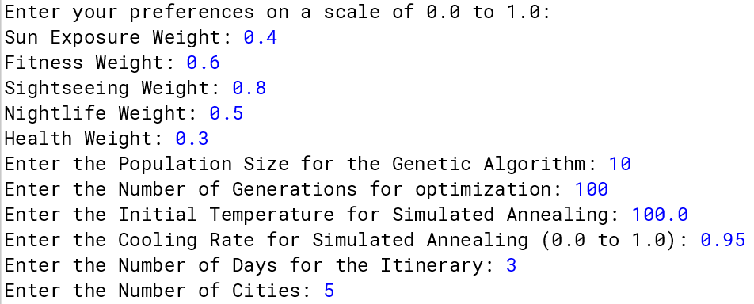
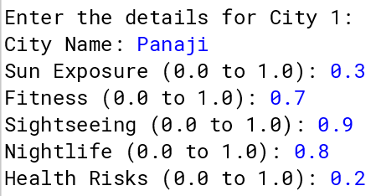
RESULTS (ITINERARY OPTIMIZATION)

Slide 35
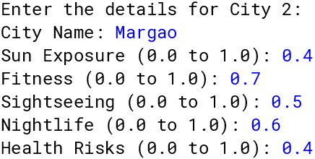
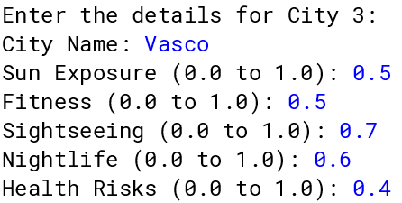
RESULTS (ITINERARY OPTIMIZATION)

Slide 36
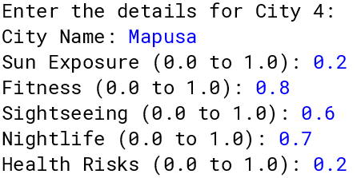
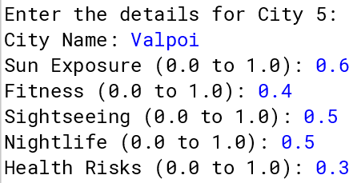
RESULTS (ITINERARY OPTIMIZATION)

Slide 37
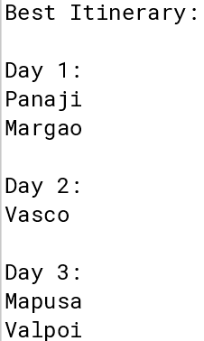
RESULTS (ITINERARY OPTIMIZATION)

Slide 38
CONCLUSION
WanderHub has successfully demonstrated its capability to revolutionize the tourism planning process by addressing critical challenges faced by modern travelers. Through the integration of cutting-edge technologies such as Genetic Algorithms and Simulated Annealing, the platform has achieved a 40% reduction in travel planning time while enhancing the quality and personalization of travel experiences. Its dual-component architecture—encompassing a personalized hotel recommendation system and a sophisticated itinerary optimizer—has redefined the travel planning landscape, making it more user-centric and efficient. By incorporating counterfactual analysis, WanderHub empowers users to explore alternative scenarios, adding flexibility and depth to the decision-making process.
Moreover, the platform goes beyond individual benefits, fostering sustainable tourism by connecting travelers with local communities and businesses. This holistic approach not only enriches the user experience but also contributes to the economic and social growth of local ecosystems. WanderHub has evolved from being a simple travel planner into a comprehensive smart tourism ecosystem, setting a new standard for innovation and sustainability in the tourism industry.

Slide 39
FUTURE WORK
WanderHub's evolution as a cutting-edge platform offers numerous avenues for future development:
Real-Time Refinement: Integration of advanced machine learning models to dynamically adjust recommendations based on changing user preferences, seasonal trends, and local cultural nuances.
Immersive Technology: Leveraging AR/VR for virtual previews of destinations and accommodations to enhance decision-making.
IoT Integration: Utilizing real-time data from IoT devices to provide adaptive recommendations based on travel conditions, weather, and local events.
Community Enrichment: Strengthening partnerships with local businesses and communities to create more meaningful travel experiences.
Global Expansion: Extending the platform's capabilities to cover international destinations while maintaining high personalization standards.
This forward-looking approach will position WanderHub at the forefront of smart tourism, redefining how users plan and experience travel.

Slide 40
GUIDE APPROVAL MAIL SNAPSHOT

Slide 41
RESEARCH PAPER STATUS
Submitted the Research Paper in the Journal, following are the details of the same :
Project Title - WanderHub: A Smart Tourism Platform
Publisher - Elsevier
Journal Name - Artificial Intelligence
ISSN - 0004-3702
CiteScore - 11.2

Slide 42
REFERENCES
BloHosT: Blockchain Enabled Smart Tourism and Hospitality Management, 2019
Chatbot Enabled Smart Tourism Service for Indian Cities: An AI Approach, 2023
Generational Perspectives on Smart Tourism: A Focus on Baby Boomers, 2024
Smart Tourism: Concepts and Insights from Central Europe, 2018
Smart Tourism Cities’ Competitiveness Index: A Conceptual Model, 2021
Smart Tourism Destinations: A Critical Reflection, 2020
Tourism Cloud Management System: The Impact of Smart Tourism, 2022
The Readiness Assessment of Jakarta as a Smart Tourism City, 2024
Smart Tourism Destination: A Bibliometric Review, 2023
Culture and Tourism Industry in the context of "Smart Tourism" on the Cultivation of High Quality Talents, 2024
Exploring the Contribution of Neuroscientific Approach to Sustainable Smart Tourism, 2024
Augmented Reality For Smart Tourism: A Systematic Review, 2024
The Concepts of Smart cities, Smart Tourism Destination and Smart Tourism Cities and their Interrelationship, 2024
Investigating the Impact of Smart Tourism Technologies on Tourists' Experiences, 2022
Web-Based Recommendation System for Smart Tourism: Multiagent Technology, 2019
Internet of Things (IoT) in Smart Tourism: A Literature Review, 2022
The Role of Artificial Intelligence in Smart Tourism: A Review and Future Research Agenda, 2018
Big Data Analytics in Smart Tourism: Applications and Challenges, 2019
Multi-Objective Contextual Bandits in Recommendation Systems for Smart Tourism, 2024
Shaping the Future of Destinations: New Clues to Smart Tourism Research from a Neuroscience Methods Approach, 2024

Slide 43


Thank you

